Slide 1
Q-Cor: online scheduling app
Brought to you by Team q:
Brooklyn Coulson
Kushagr Bhatnagar
Vaughn Geber
Notes:
Hey everyone, we are team Q and for this project we developed Q-Cor which is an online scheduling application geared towards helping university students stay organized

Slide 2
Team q: who we are and our roles
Vaughn: back end/front end development
Kushagr: front end/back end development
Brooklyn: documentation manager, meeting planner
Notes:
Before we get into the details of our application we’re going to briefly touch on our roles within this project. At first we were going to try and divide the tasks evenly be it documentation or the physical coding. We quickly discovered this was inefficient so instead we utilized our strengths and ended up with Vaughn mainly working on the back end development, Kush working on the front-end development and I was mainly in charge of the documentation and coordinating meetings.

Slide 3
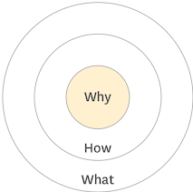
Golden circle: why?
Students navigating post secondary education can be an exciting yet harrowing experience
Initial excitement wears off when due dates quickly pileup
Managing multiple classes and group projects can quickly become overwhelming when trying to organize:
due dates for assignments
exam dates
deadlines for project checkpoints
meetings for group projects
navigating availabilities for coordinating group check-ins
Notes:
Now diving into the project itself, why did we choose to pursue the online scheduling app? As university students, we know navigating everything post secondary education has to offer can be a thrilling, yet harrowing experience. The initial excitement of joining interesting clubs, making friends, and discovering new passions tends to wear off quickly once the due dates begin to roll in. Managing multiple classes and group projects can quickly become overwhelming when trying to organize a multitude of events including due dates for assignments and exams, deadlines for projects and trying to coordinate check-ins.

Slide 4
Golden circle: how?
By utilizing the internet, students can conveniently access our scheduling app from any device that houses such a connection
Communication done between fellow classmates and group members can be done within the same app
Notes:
By sharing this experience at one point within our university career, we brainstormed ways in which we could make managing daunting course loads a bit easier. With convenience one of our major factors, we thought that having an application easily accessible via the internet would be ideal. This way a student could access this app at a moments notice, be it at home planning the week or when they’re out and want to see if they’re available for a weekend excursion. Another aspect relaying to the convenience theme was one relating to communication. With traditional schedulers, you require an external app in order to communicate with group members which can sometimes be a hassle when trying to plan meetings based on everyone’s availabilities.

Slide 5
Golden circle: what?
Q-Cor is an online scheduling application that can be accessed via the internet
Users of this app will be able to invite other classmates/group members to view shared calendars
Can edit the calendar in a multitude of ways:
adding, removing, amending, sorting items
In-app messaging function allowing easy communication between members
students will no longer need a separate application in order to stay in touch and communicate with classmates and group members
Notes:
As a result we came up with the idea of Q-Cor; an online scheduling application that can be conveniently accessed by any device housing an internet connection. Users of this application will be able to invite other classmates/group members to view shared calendars. Those invited will be able to edit the calendar in a multitude of ways including adding and removing dates, amend pre-existing items and sorting them in terms of importance. There will also be an in-app messaging function that will allow easy communication between members within the same calendar to converse on topics like coordinating study sessions, course content discussions, and clarifying any assignment or exam requirements. By supporting this in-app chat function, students will no longer need a separate application in order to stay in touch and communicate with classmates and group members.

Slide 6
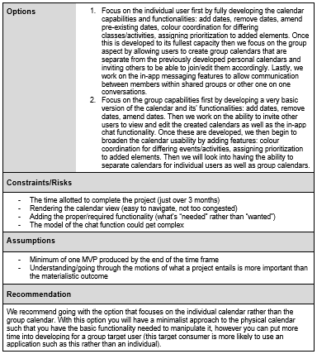
Planning phase for q-cor… business case
2 options to choose from:
Develop a fully functioning calendar for a single user; then bring in group activity (shared calendars, in-app chat messaging)
Develop a basic calendar and fully develop group activity (shared calendars, chat messaging); then increase calendar functionality
Recommendation: fully functioning calendar with group activities as a second MVP
Notes:
After deciding on our project idea, as a group we came up with 2 different options on how we wanted to approach this idea. The first option would focus on the individual experience first by creating a fully functioning calendar prior to focusing on the social aspect of the project. The second one would try to prioritize the group functionality by creating a very basic calendar view, and then focusing on the calendar sharing and messaging before finishing up the calendar functionality. After some debate, we decided on option 1.

Slide 7
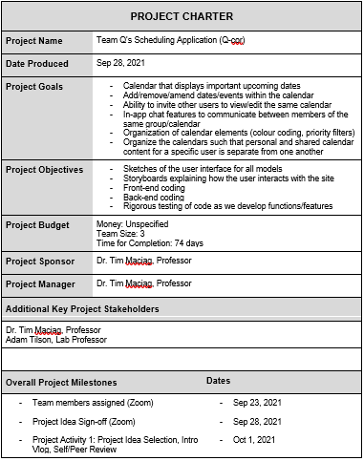
Planning phase for q-cor… project charter
The option prioritizing the full functionality of the app over the group activities was chosen
In doing so, we essentially cut the project in half in terms of MVP’s:
1st MVP: focus on the individual user by allowing them to signup, login, view the calendar, manipulate dates within their calendar
2nd MVP: integrate the group functionalities by allowing users to share calendars, differentiating/separating group and personal calendars, and in-app chat interaction between members
Notes:
Once we knew how we would approach the project, we decided to define our project deliverables. We essentially decided to chop our project in half, having our first MVP include everything to do with the calendar view and being able to manipulate it accordingly. The second MVP would constitute the group activities including sharing calendars and messaging.

Slide 8
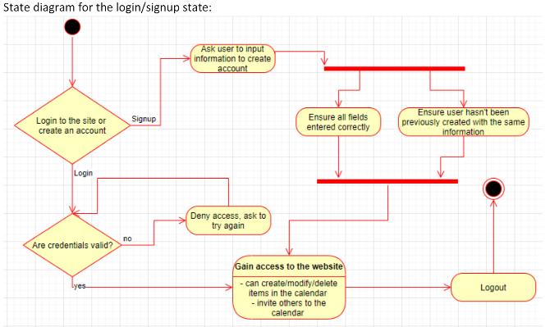
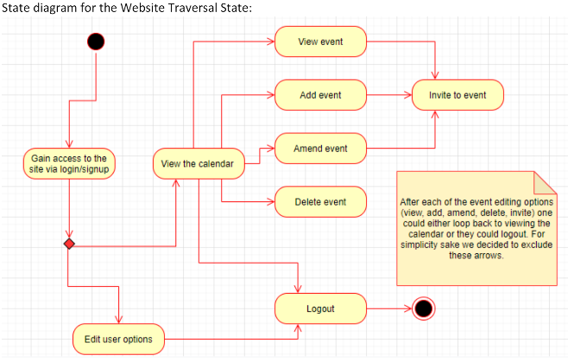
Picturing the deliverables
Once we started with the layouts, and drawing out the interactions we began to have a better understanding of the project itself and where we wanted to go with it

Slide 9
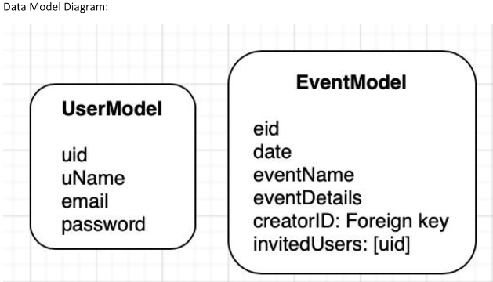
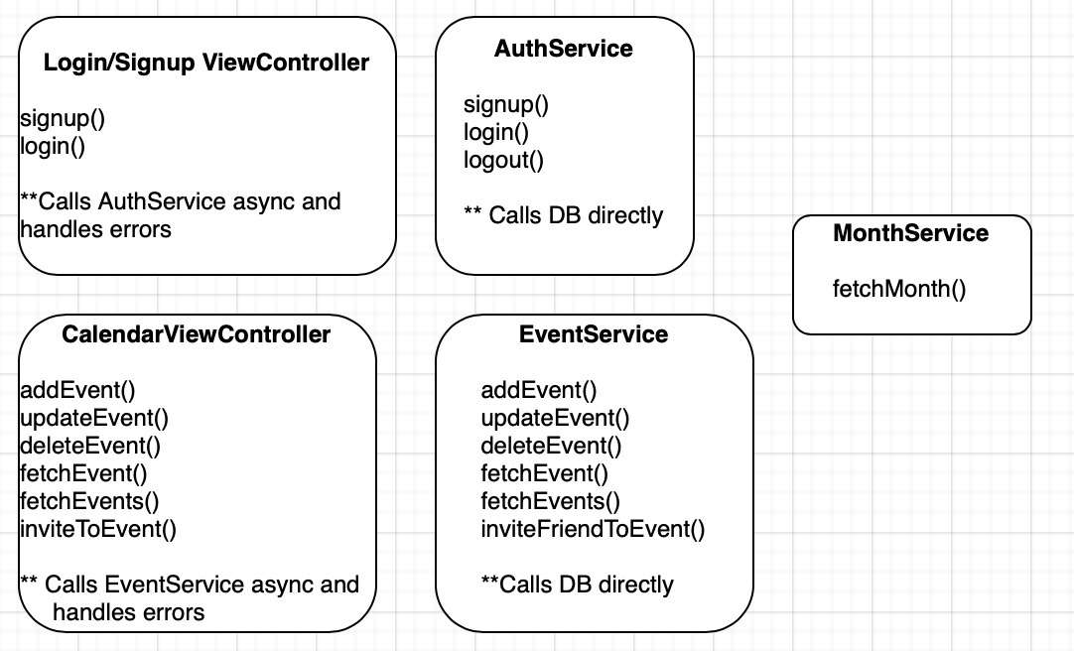
Picturing the structure

Slide 10
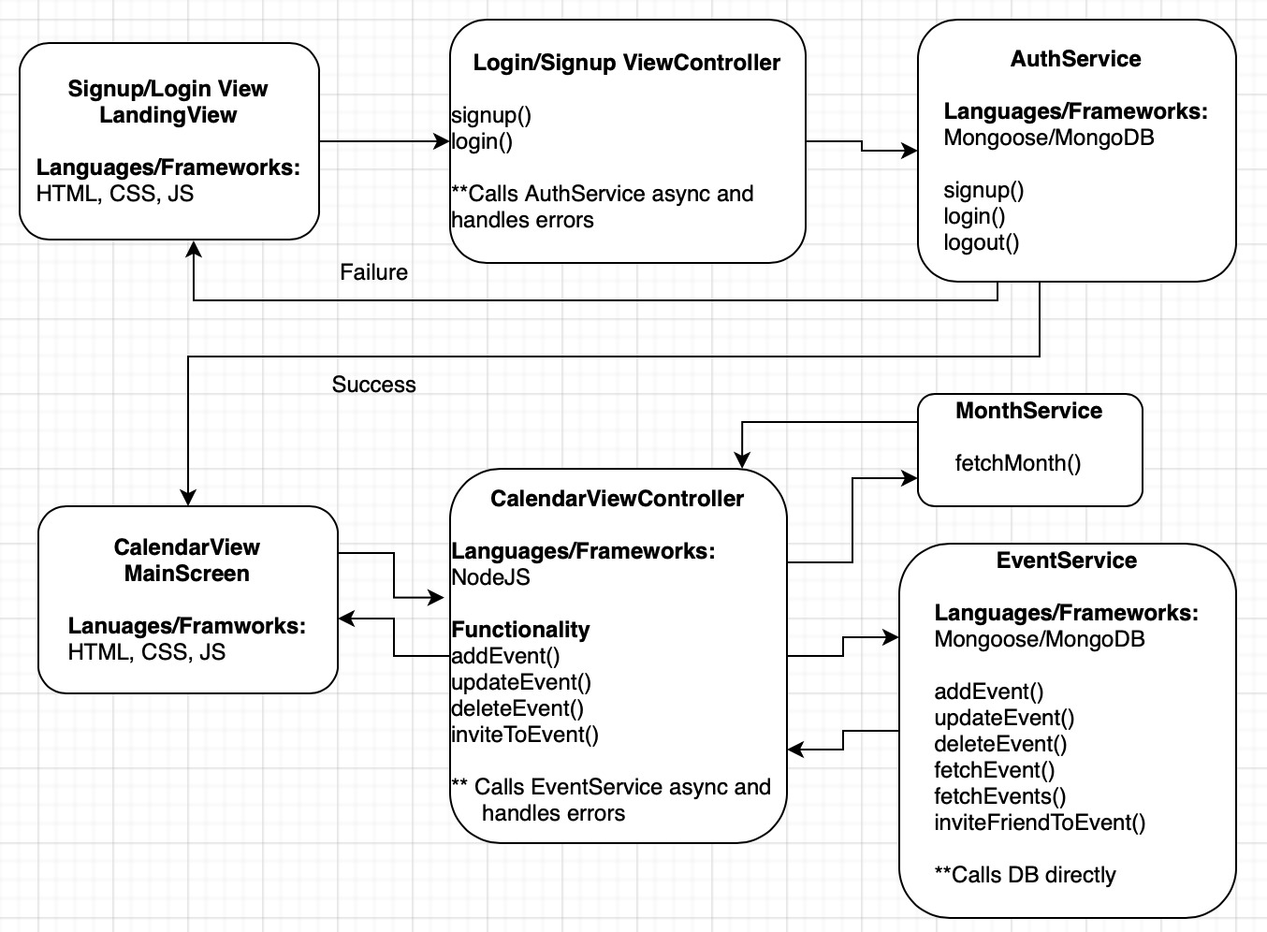
Last steps before coding
By mapping out the relationships of our data structures and how they interact with one another via the state diagrams, we were able to visually finalize our planning with a proper MVC diagram

Slide 11
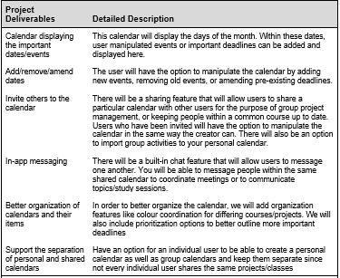
Project scope as time progressed
It became clear as the semester came and went we would have to refine our scope (bit off more than we could chew)
Due to inexperience things took longer than anticipated
The organization/prioritization features of the calendar and the ability to have separate/multiple calendars would be redefined as the 2nd MVP
The sharing of the calendars and the chat functions would be moved to a 3rd MVP
Notes:
As our project progressed we found that our MVP’s did constitute a lot considering our time frame and level of coding experience. To try and make things a little more realistic, we converted our two MVP’s into three. The login/signup, calendar view and basic manipulation of the calendar would be part of the first MVP, the organization of events and having multiple calendars would be part of the second and the third MVP would now include sharing calendars and the chat functions.

Slide 12

Now for a brief demo…

Slide 13
Reflections
For the scope of this project it was more efficient to have full stack developers rather than having separate front end and back end developers
The time given to complete a viable MVP was challenging but also helped to engrain the importance of communication within a group setting
We felt that we wanted to make our site more appealing to the user so we wanted to have more focus on the view rather than having all the functionalities complete

Slide 14

Questions?

